Slide 1

Impact of Social media in shaping a major outbreak (COVID-19)
Presented By:
University of Windsor, Master of Applied Computing Team:
Adarsh Sai Gupta
Sadman Hasan
Samir Shahriar
Anas Shah

Slide 2
Content
Overview
Methodology
Database
Results
Hypothesis
Conclusions

Slide 3

Overview
The optimistic view is that social media could prove useful at a time when many of us are otherwise isolated from one another
Conversations around the coronavirus, especially those at the community level, can help us navigate this crisis
But several users on these platforms are spreading rumors and other misinformation at a time when people are emotionally charged and looking for valid information

Slide 4
Methodology: Data Extraction
Tweepy:
To Collect Twitter Data using Python
Geopy:
To Extract corresponding location of Tweets.

Slide 5
Methodology: Data Preprocessing & NLP
Noise Removal
Filter out native language tweets
Sentiment Analysis
Calculating Mean for Each Country

Slide 6
Database: PostgreSQL
Object-relational database management system
Developed based on POSTGRES 4.2
Open source and available under PostgreSQL license
What makes it standout?
Multi-version concurrency control (MVCC)
User-defined types
Supports ACID
Table inheritance
Apple, Red Hat, Cisco, Juniper Network etc.

Slide 7
Database: Process
Result generated from 50,000 data stored in Database
This includes category(#tags), tweets, date, location, latitude, and longitude
Once data is stored, we are using SQL queries to fetch and pour it in Microsoft tool called Geographical heat map
This heat map is used for making inference and future prediction on our Big Data, i.e. converting information into wisdom

Slide 8
Results
Captured Twitter data of the keywords like #corona, #virus, #coronavirus #outbreak #panic #shortage #pandemic #toiletpapers
Mapped responses of these words in a world map to showcase…..
For this presentation we are only considering 15 days difference in collection of data and comparing them with the actual outbreak or number of cases of COVID-19

Slide 9
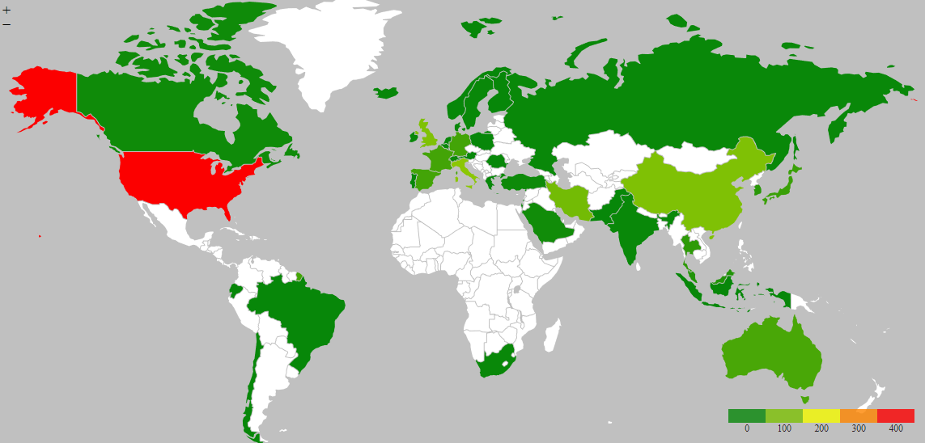
#CoronaVirus Tweets – 15th Feb

Slide 10
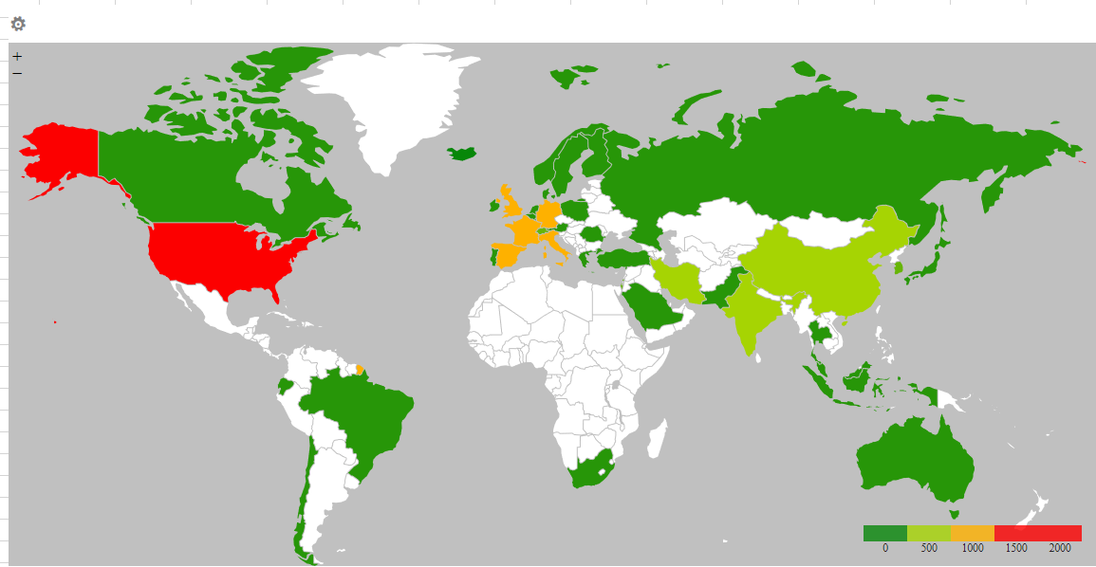
#CoronaVirus Tweets – 1st March
Notes:
01March

Slide 11
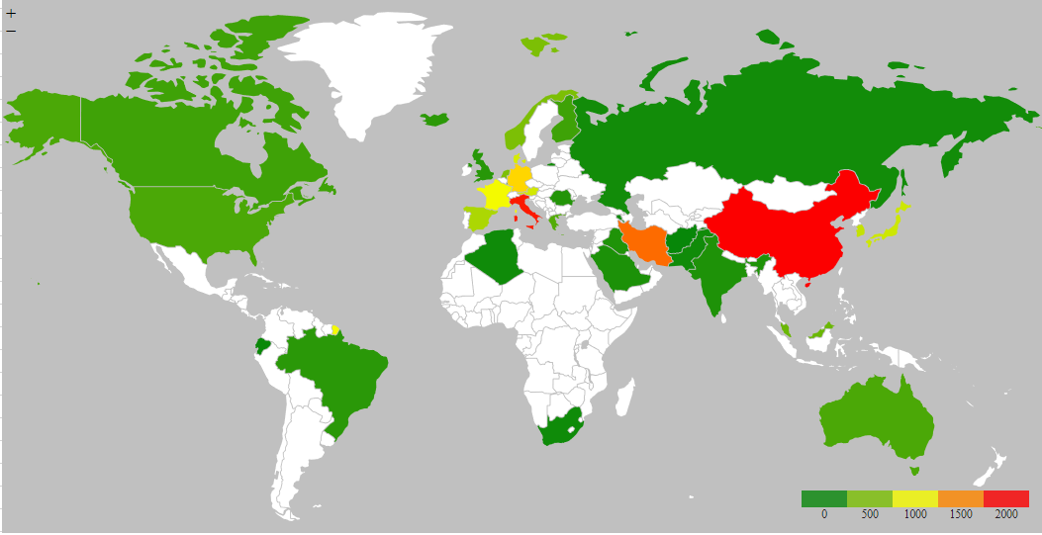
Confirmed Cases – 15th March

Slide 12
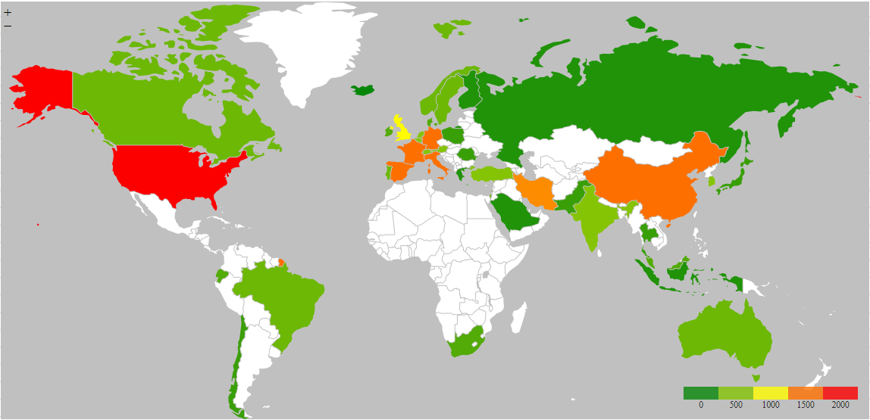
#CoronaVirus Tweets – 15th March
Notes:
15March

Slide 13
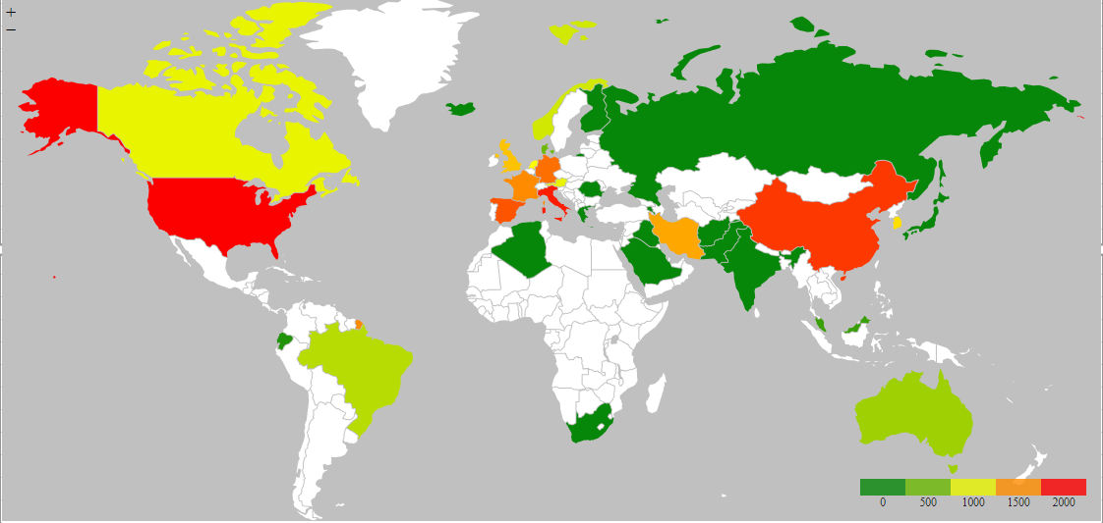
Confirmed Cases – 27th March

Slide 14
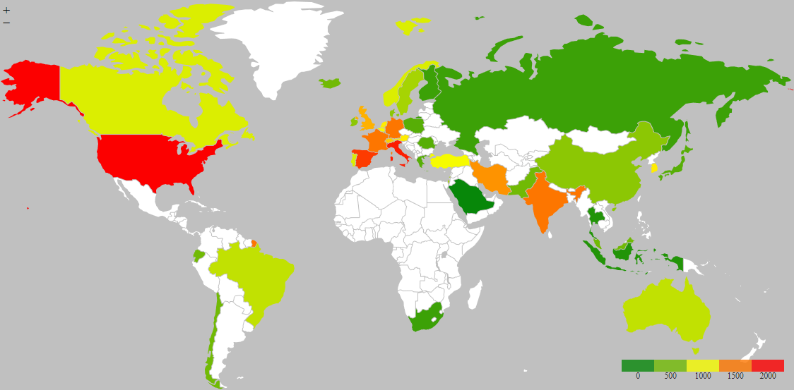
#CoronaVirus Tweets – 27th March
Notes:
27March

Slide 15
Hypothesis
As per our analysis, we see a lot of tweet coming from countries that are in orange, and the reported cases in these countries are still less compared to others
Our assumption is in next 15 days, we are going to see a increase in no of cases in these countries. i.e. France, Germany, India, and United Kingdom
This is not a scientific results and assumption might change as more countries are aware of this situation and taking drastic measure to mitigate the effect like social distancing or lockdown

Slide 16
Conclusion
Right now, the world is battling a coronavirus epidemic. However, this study indicates that the issue is larger than just the spread of the virus
Our Data shows whenever a country start to tweet more about this virus outbreak, there is spike in number of cases in that country
Surely virus is not spreading through social media, which means, these tweets are creating some sort of fearmongering
We believe misinformation spread through these platforms create panic among general population, leading them to take drastic measures instead of what is recommended

Slide 17
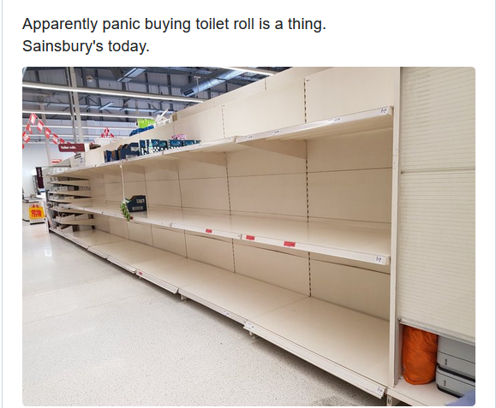
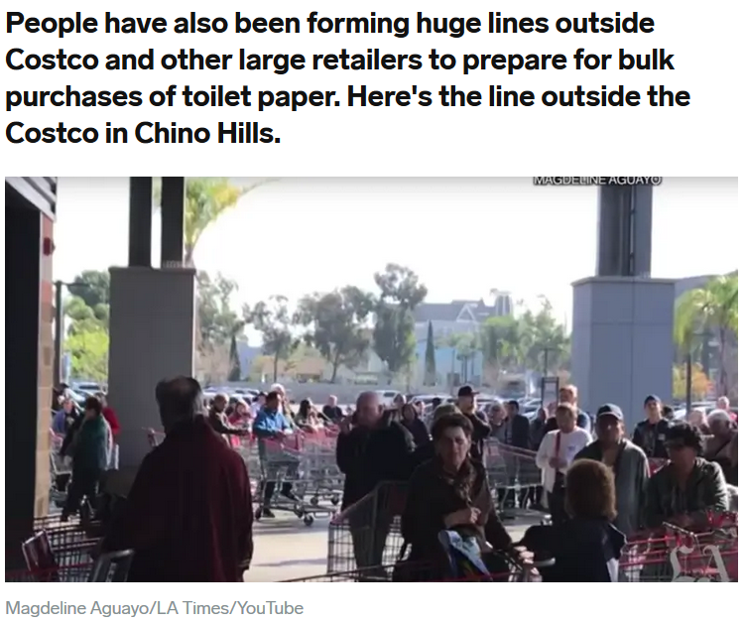

Slide 18


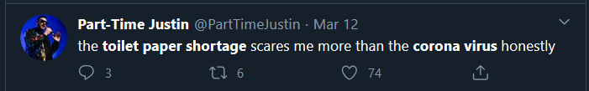
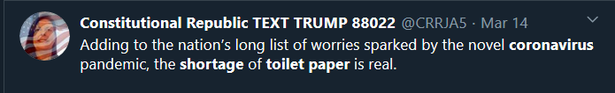
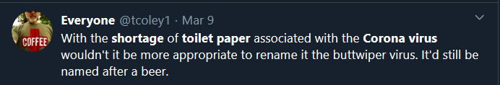
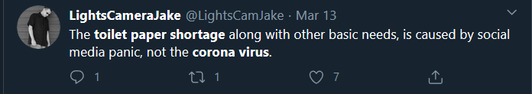

Slide 19
Thank You! Questions?
“We’re not just fighting an epidemic; we’re fighting an infodemic.” WHO Director-General Tedros Adhanom Ghebreyesus

